Slide 1

Reading and Annotation Tools
for Classical Languages
Bridget Almas
LiLa Workshop
June 3, 2019, Milan
@Alpheios

Slide 2
Mission
Alpheios builds evidence-based, open-source software to support worldwide study of classical languages and literatures.
@Alpheios

Slide 3
Alpheios Features
Lemma
Morphology
Short Definitions
Full Definitions
Grammar
Inflection Tables
Word Lists
Usage Examples
Via PHI service
Lemma Translations
Collatinus Data
Treebank Diagrams*
Via Arethusa
*when available
Translation Alignments*
*pending new UI
@Alpheios
Notes:
Alpheios enhances online classical texts with the following features, all of which are either released or currently in beta testing.

Slide 4


Alpheios Applications
Browser Extensions
ANY page accessed in the browser
Embedded Library
Alpheios Reader
Digital Latin Library, Beta maṣāḥǝft, Digital Editions, Websites, GitHub Pages, LMS ….
@Alpheios
Notes:
Alpheios functionality can be brought to an online text in a number of different ways.
The traditional approach has been to use the Alpheios Browser Extensions, which, when added to your Chrome, Firefox or Safari browser, enable all of the Alpheios features in any text you can read in your browser.
We also now provide a Javascript library which can be embedded directly in a web site or application. This allows for site-specific customizations of the Alpheios UI, and, with the next major release, will include full support for use on mobile devices. We use this library in our own reader environment, it is also used in the Digital Latin Library, the Beta maṣāḥǝft library and be easily added to online digital editions, websites, github pages, learning management systems and so forth.

Slide 5

Alpheios Browser Extensions
Notes:
I’ll give a quick run through of the Alpheios webextension functionality. The screenshots are from the 3.0 beta version of our codebase which is not quite available yet in the browser extensions.

Slide 6
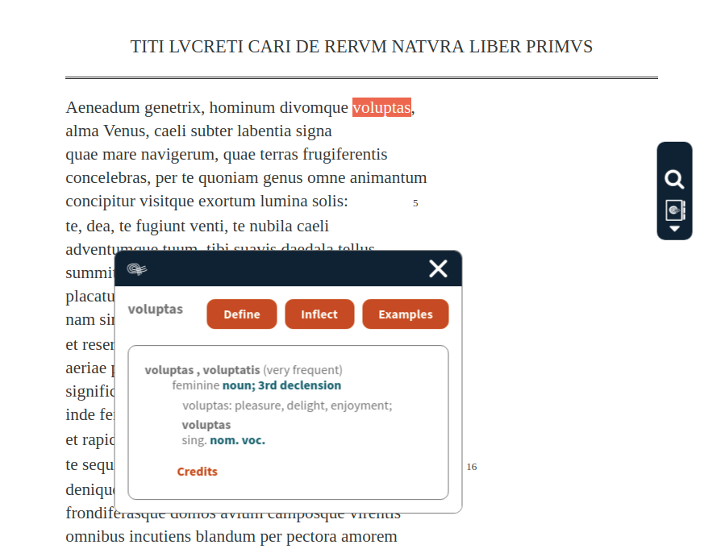
@Alpheios
Notes:
When you activate Alpheios for a page, it adds a toolbar and an event handler for word selection. Double-click on a word and you will get a morphological parse, identification of lemmas and a short definition. From here deeper word study can be performed.

Slide 7
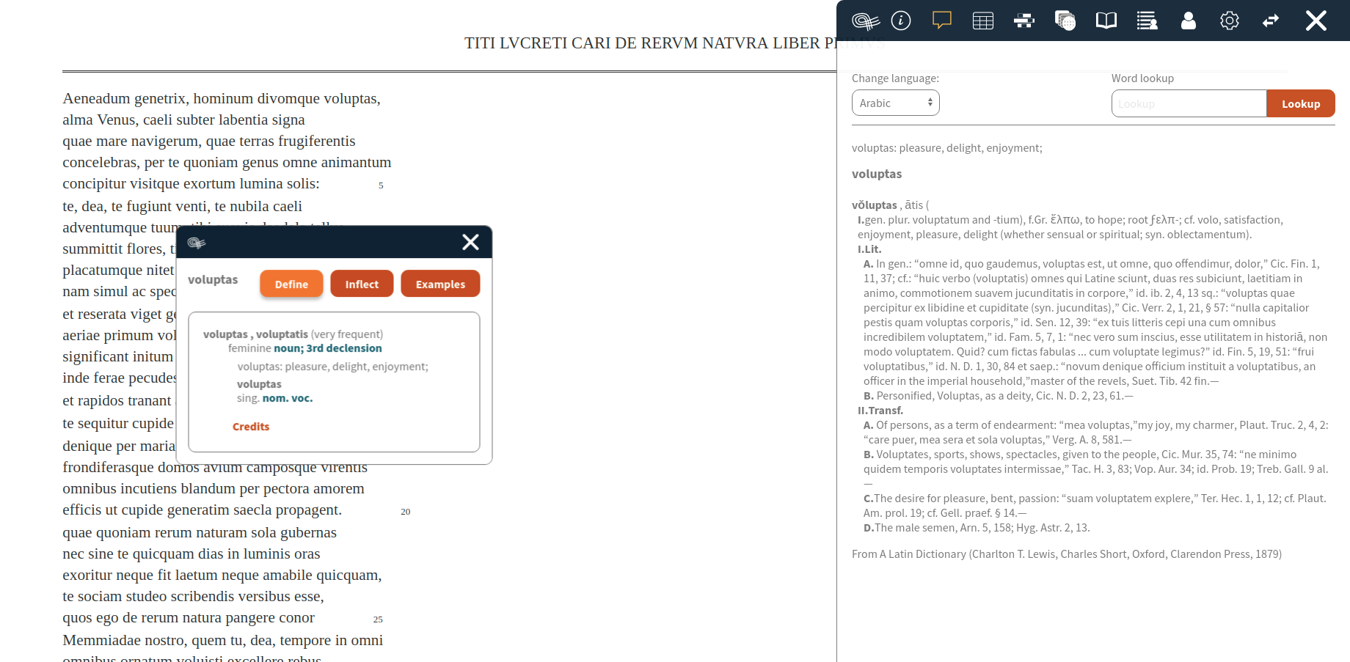
@Alpheios
Notes:
Clicking the Define button will bring up a full definition from one of the available lexicons. We use Lewis and Short for Latin. Greek has a number of lexicons available, we also have Arabic and Persian.

Slide 8
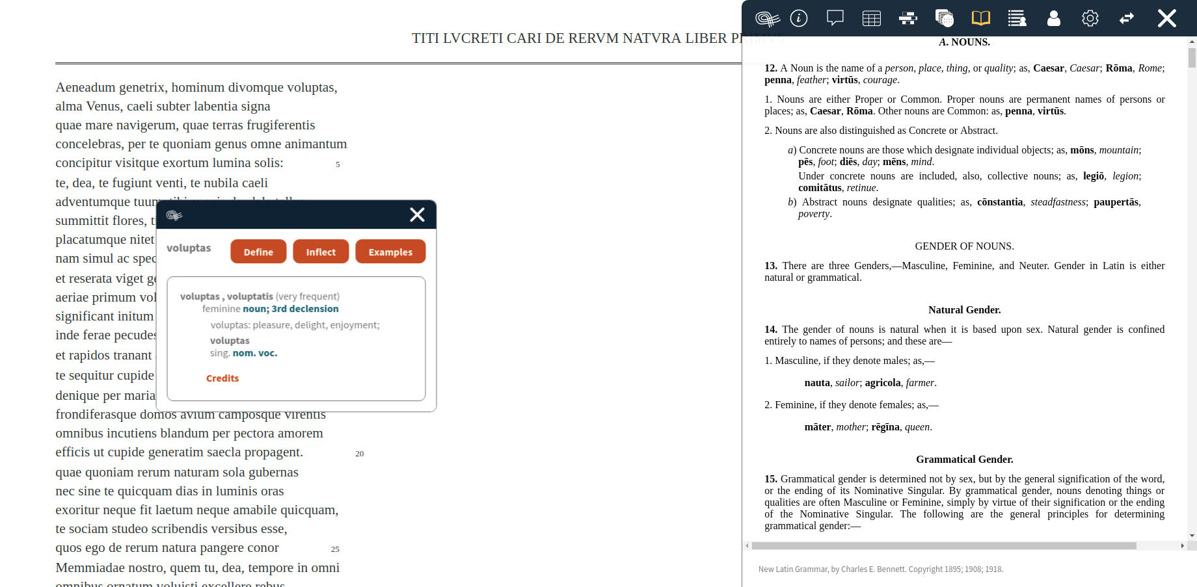
@Alpheios
Notes:
Clicking on a linked grammatical term will bring up the relevant section of a linked grammar. We currently use Bennett for Latin and Smyth for Greek. We’d really like to add the Allen and Greenough Grammar for Latin as well.

Slide 9
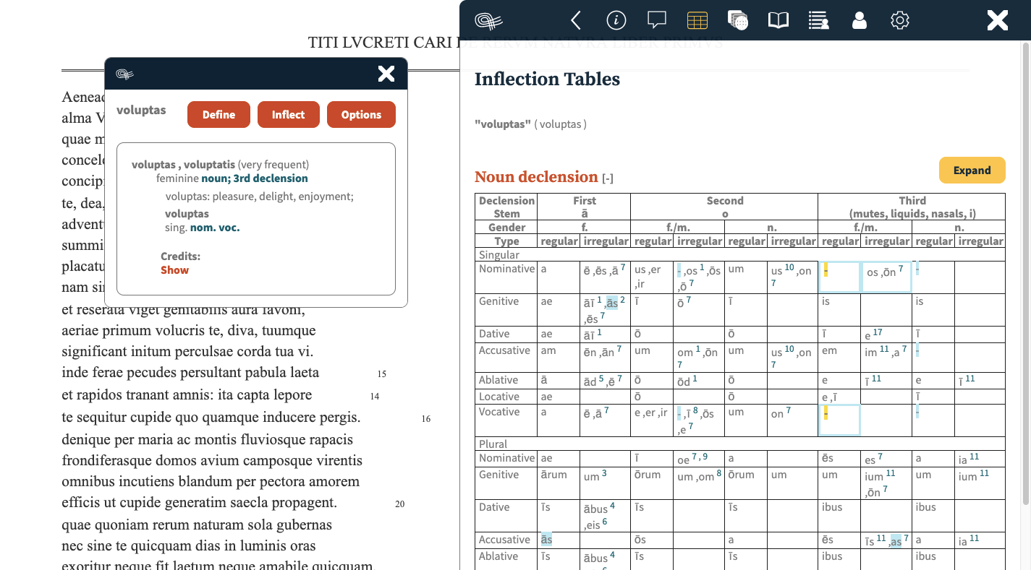
Notes:
Clicking the Inflect button will bring up inflection tables focused on the matching inflections.

Slide 10
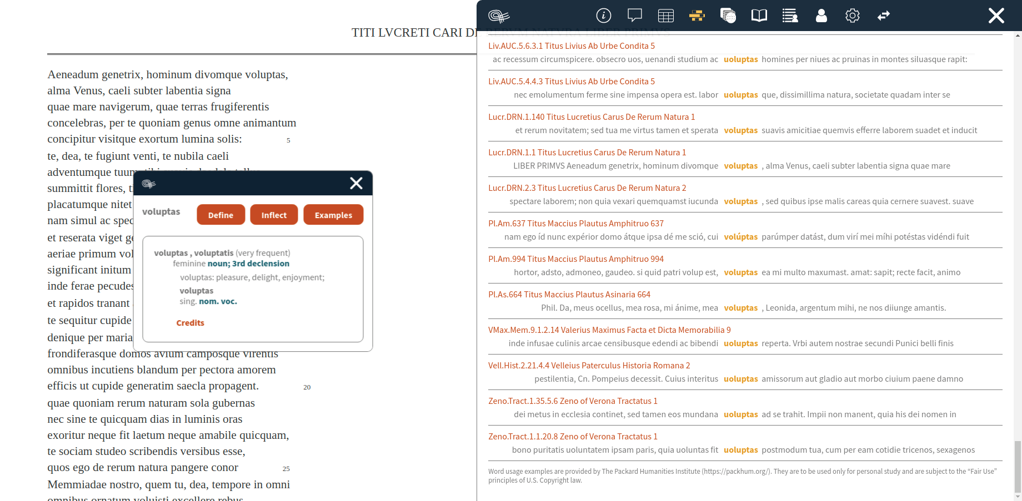
@Alpheios
Notes:
Clicking the Examples button will enable you to retrieve other examples of the selected word from the canon. We use a concordance service provided by the Packard Humanities institute for this. (This feature is currently available only for Latin). You can follow the links to the source to see the word in context in the corresponding text in the PHI library.

Slide 11
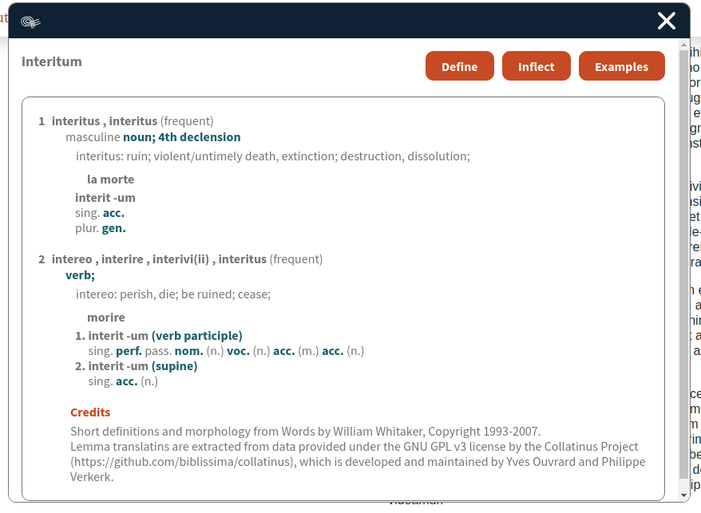
@Alpheios
Notes:
Another experimental feature for Latin is the ability to add lemma translations to the popup. We use the Collatinus data for this. Here we include the Italian translation. French, Spanish, Portuguese, German and Catalonian translations are also available from Collatinus.

Slide 12
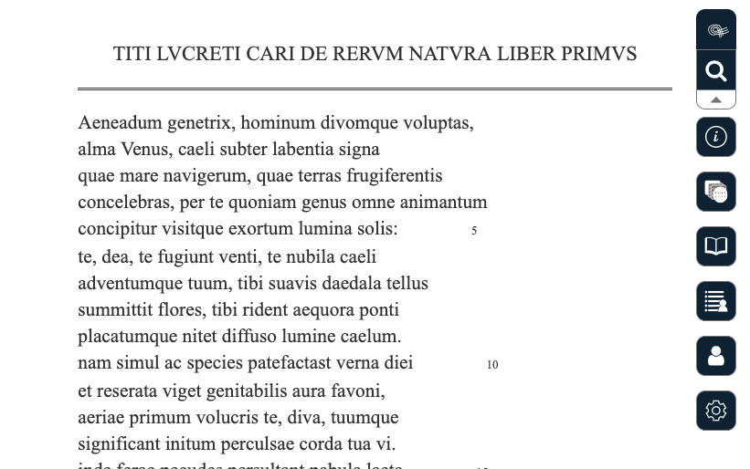
Notes:
At any time, you can expand the Alpheios toolbar to get access to browse the full set of Latin and Greek inflection tables, the grammars, your wordlist, login to your account and configure your preferences.

Slide 13
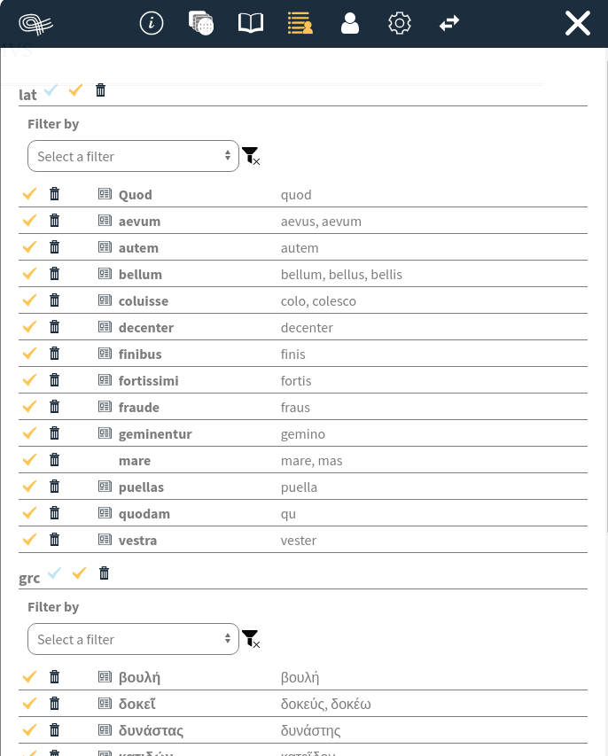
@Alpheios
Notes:
Once you login to a user account, every selection of a word adds that word to your accumulated wordlist, along with its lemmas and the contexts in which you have looked up that word.

Slide 14
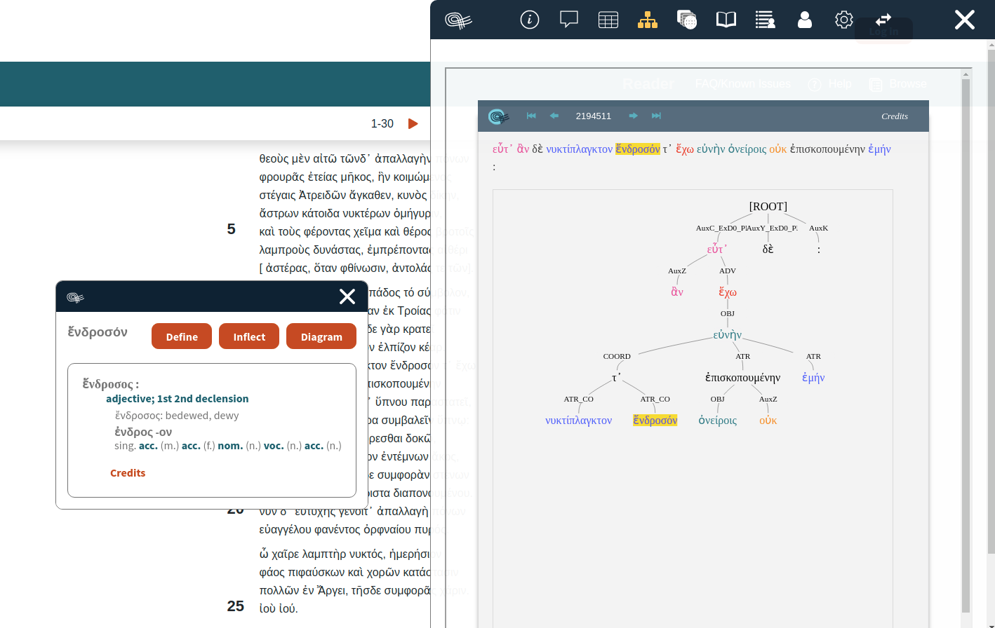
@Alpheios
Notes:
For those texts which have been aligned with treebank annotations that have been loaded in our service, you can view the tree for the selected words in the Arethusa viewer. We expect to expand this feature to allow for trees made available in other services to be able to be shown as well.

Slide 15
Alpheios Reader
Notes:
Increasingly though, people want to read online texts on their mobile devices. Unfortunately, browser extensions are not universally supported on mobile browsers. So as an initial step to provide and experiment with mobile support for the Alpheios tools, we are using the Alpheios embedded library, the CapiTainS framework and the Perseus canonical texts repository to offer a reading interface with a responsive UI that provides access to the core canonical texts as well as the word lookup and other tools.
This is some of the same technology and data as used by the Scaife Viewer, obviously, but our approach and, and I think our goals, are very different. As with Scaife, we use the Nautilus server from CapiTainS framework but we decided to extend the CapiTainS Nemo flask application to provide the user interface.
Alpheios’ goals have never been to publish a comprehensive library of texts, but instead to increase access to classical literature in its primary source language for as many people as possible by enhancing whatever text they want to read with supporting tools and annotations. And our long term goal of studying individual differences in language learners depends upon our ability to reach learners from the very beginning of their studies and follow their progress as closely as possible to permit the accumulation of extremely fine-grained prospective data on the challenging but uniquely informative process through which individuals gain proficiency in these highly inflected classical languages.
In collaboration with several leading experts in second language acquisition, computer assisted language learning and game design, we envision developing a suite of learning games that lets the individual learner pick and choose what they want and need to do, when, where and with what texts, and records the outcomes together with whatever other characteristics of the individual we can capture. Following the development of proficiency in individual students over time should allow us to see how generalizations about the relative advantages of different learning methods must be constrained by different learner characteristics at the same time that we are learning how best to support the distinct learning goals of each unique student. These kinds of comparisons can only be made with big data accumulated automatically and feeding a formative assessment system that tries to improve the student's experience while incrementally validating and articulating its own conclusions.
The Alpheios reader is in this sense a stepping stone that we were able to build quickly by relying existing open source technologies to begin to learn what interface features work best for reading and learning and how best to accumulate the resulting data over time.

Slide 16
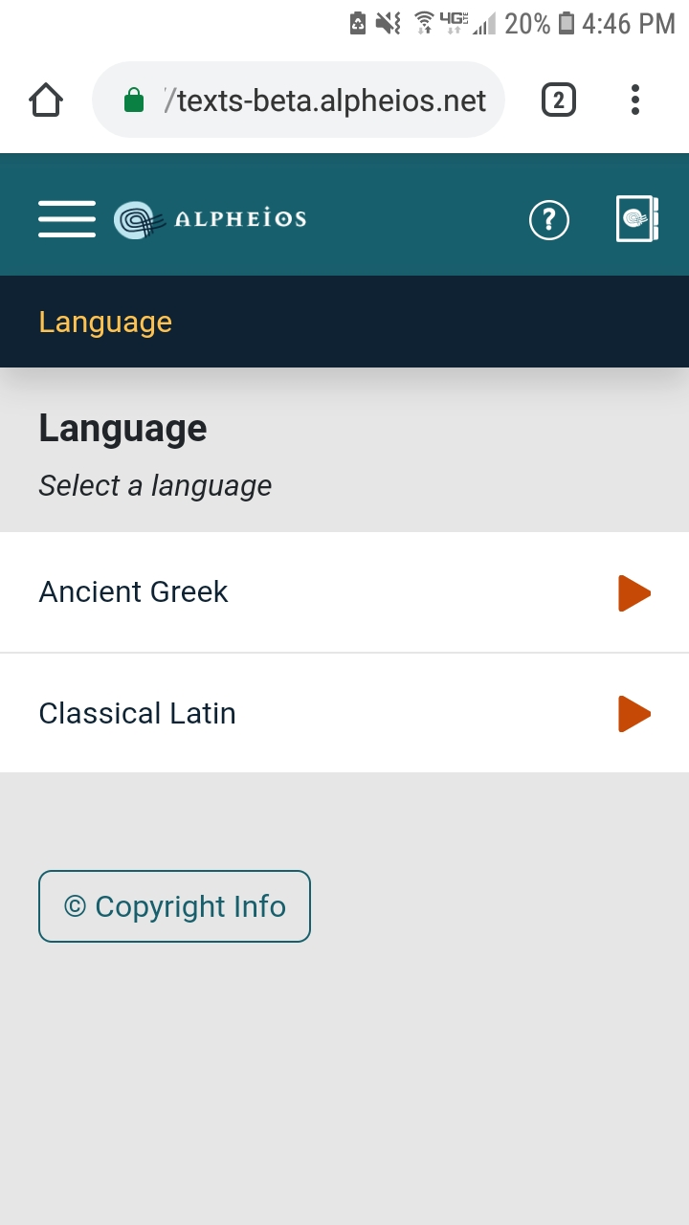
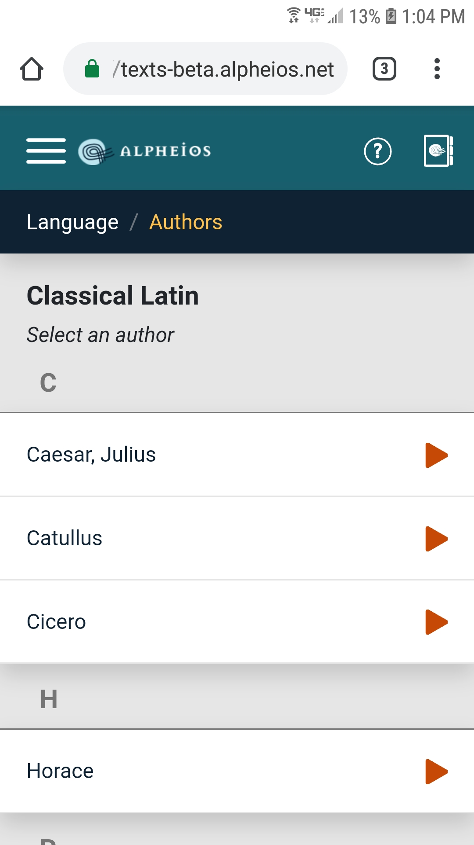
@Alpheios
Notes:
Here is a brief look at the mobile UI of the Alpheios Reader

Slide 17
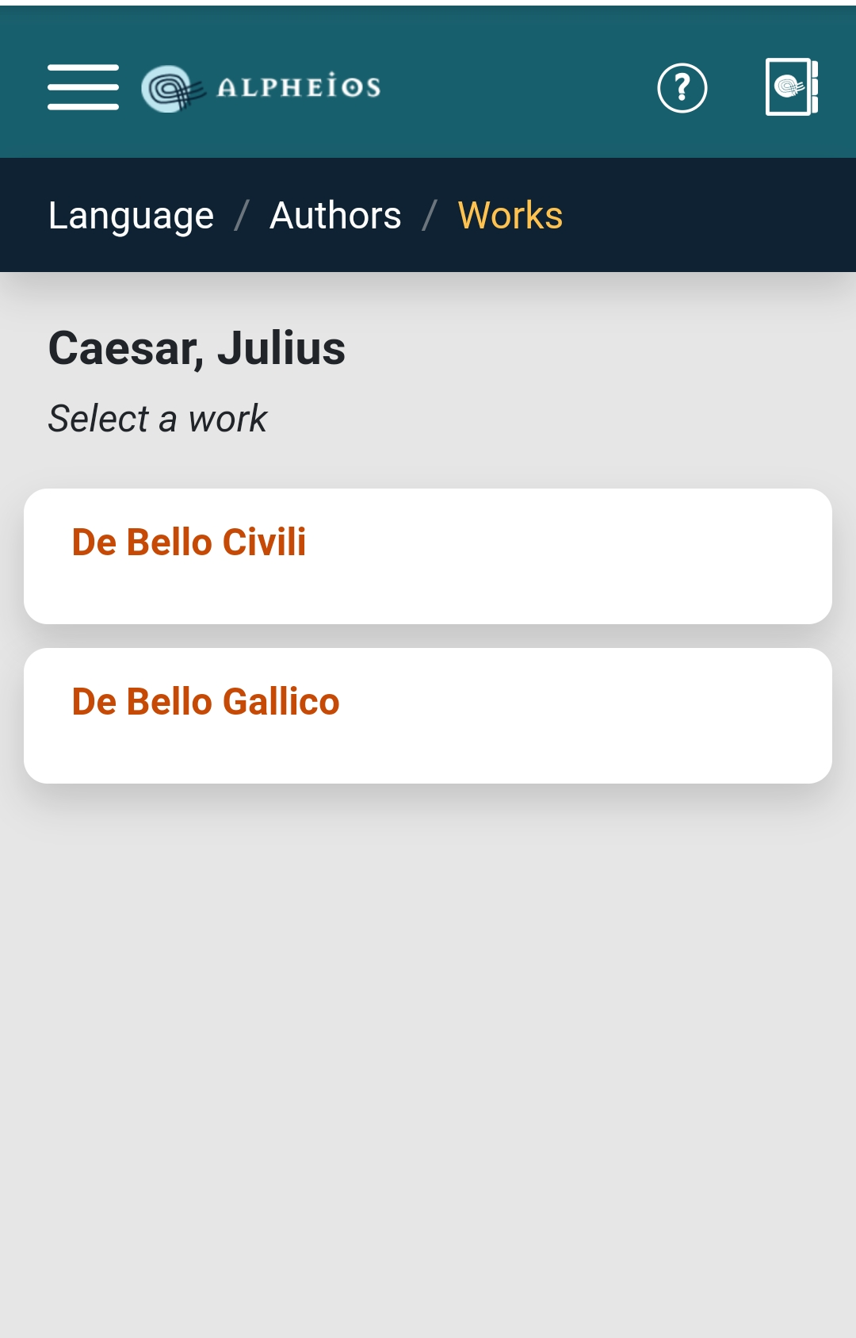
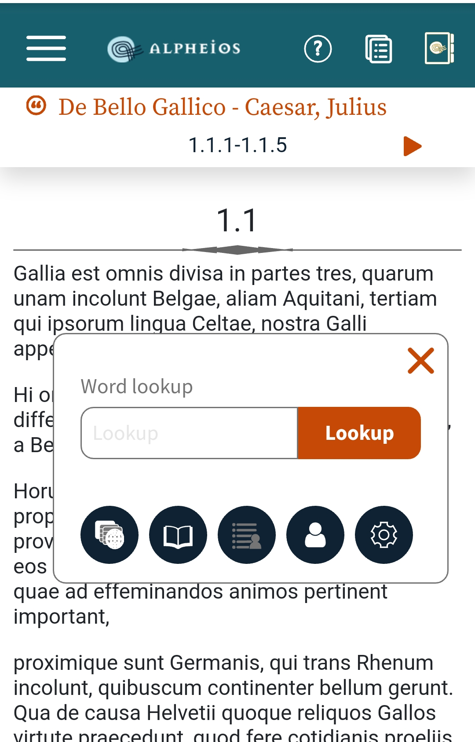
@Alpheios

Slide 18
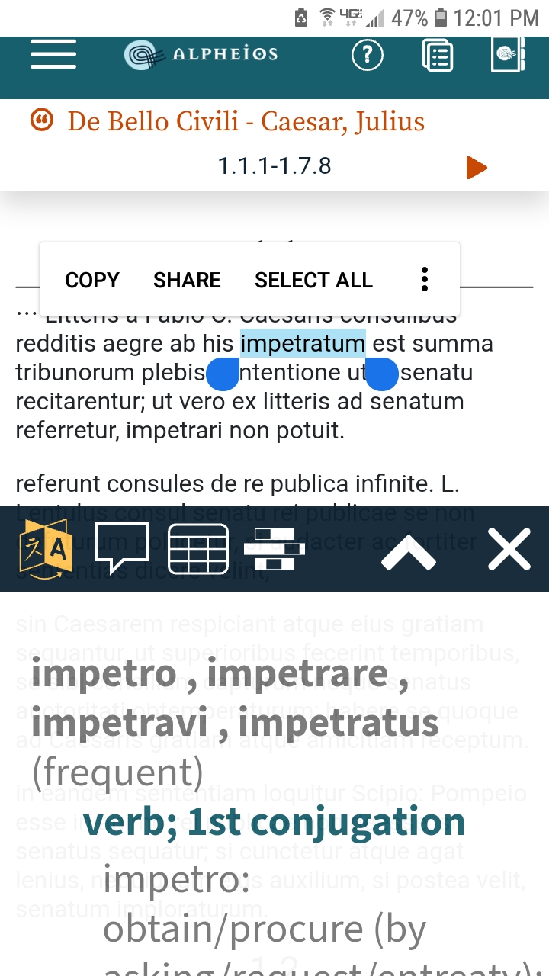
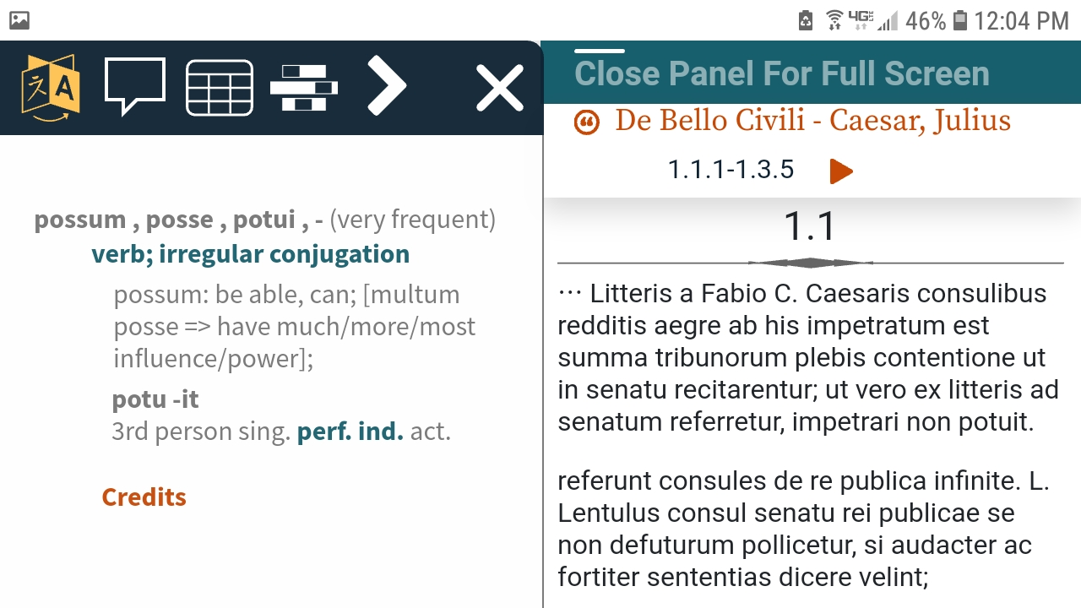
@Alpheios

Slide 19
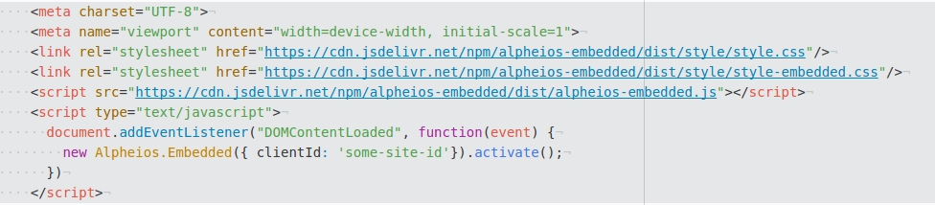
Embedded Library
Embedding site can customize :
Branding (colors, fonts, etc.)
Positioning/anchoring of UI
Event triggers and callbacks
Preferred dictionaries and other resources*
*pending interest in this feature
@Alpheios

Slide 20
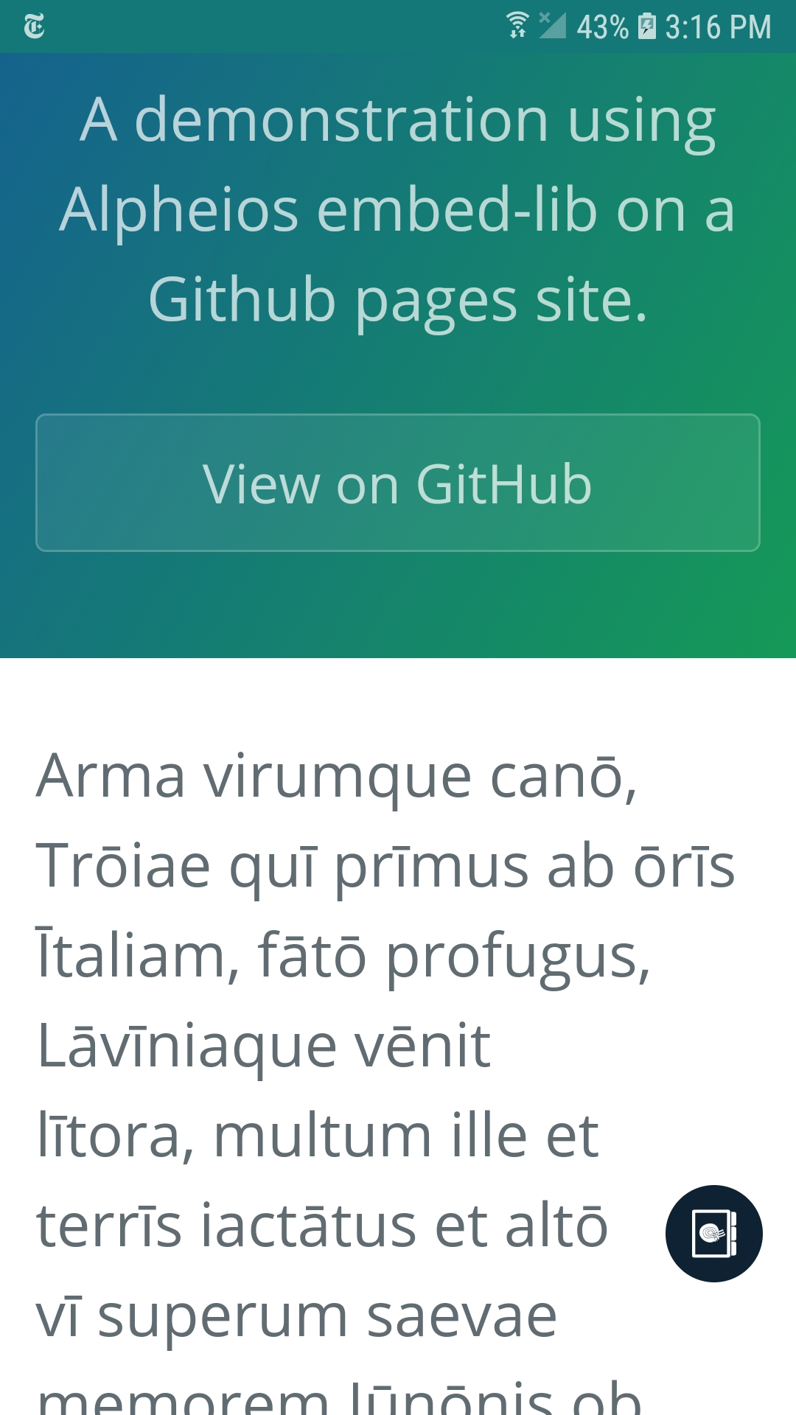
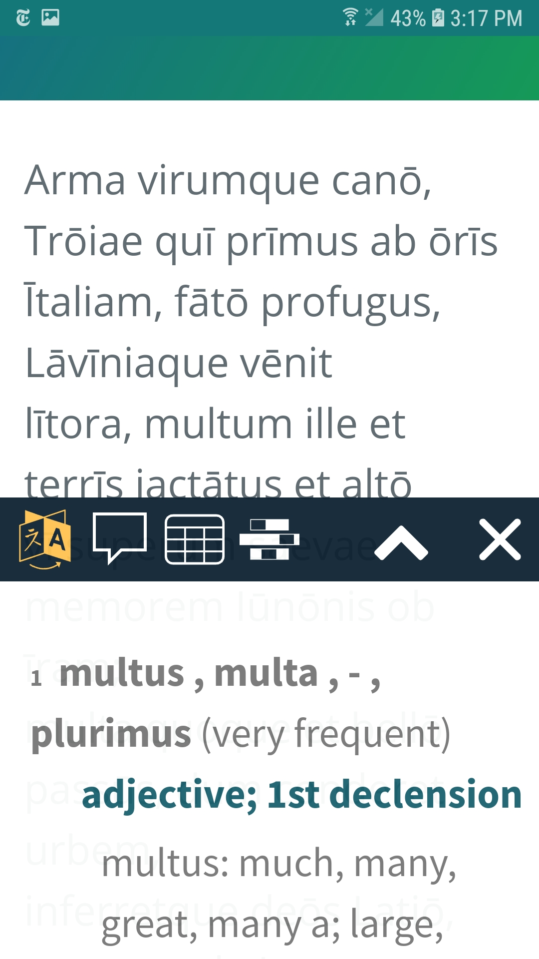
@Alpheios

Slide 21
Supporting Resources
Ancient Greek Tutorials
Auth0
Beta maṣāḥǝft
CapiTainS
The Center for the Advanced Study of Language (CASL) at the University of Maryland, College Park
Collatinus
The Digital Latin Library
LASLA (not yet but soon…)
The Packard Humanities Institute
The Perseids Project at Tufts University
The Perseus Digital Library at Tufts University
The Perseus Latin and Ancient Greek Dependency Treebanks
QAMUS LLC
The Roshan Institute for Persian Studies at University of Maryland, College Park
Whitaker's Words

Slide 22
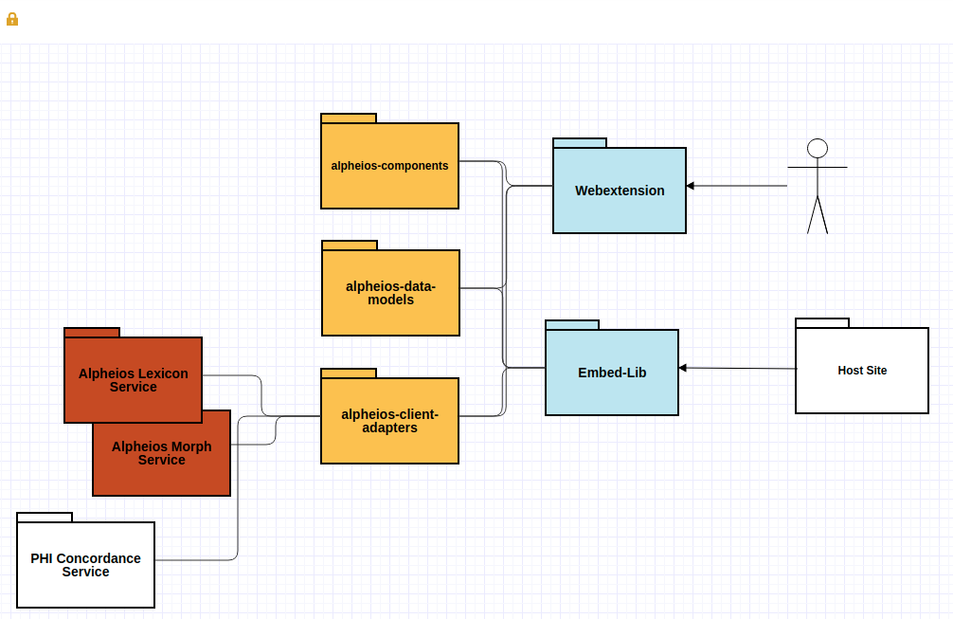
@Alpheios
Notes:
To give you a sense to how we have tried to design the code to facilitate inclusion of new linked resources, here is a simplified view of the architecture. The Alpheios applications, that is the webextension and the embedded library, bundle a set of core alpheios libraries (the full set is larger than what is shown here). The bundling application can configure certain aspects of how the libraries are used. A host site for the embedded library, such as the Alpheios Reader, can also direct the configuration. The Alpheios client adapters library is responsible for interfacing with the different resource-providing web services, some of which are hosted by Alpheios and some of which are 3rd party services, such as the PHI concordance service.

Slide 23
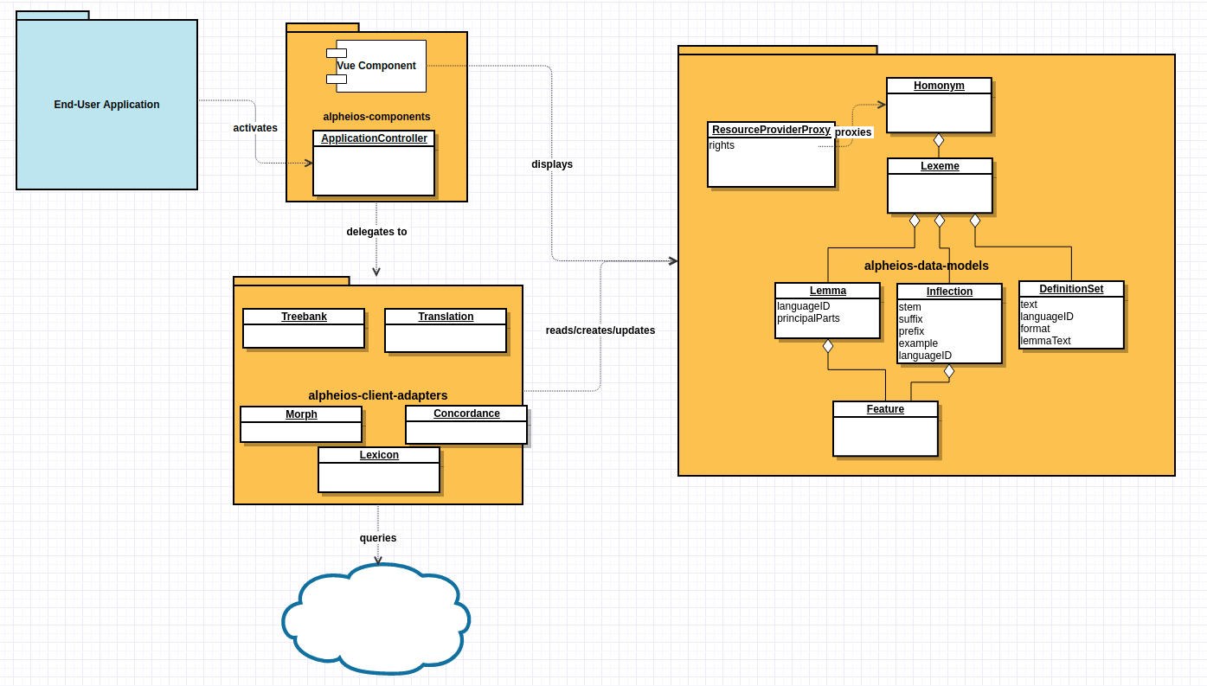
@Alpheios
@Alpheios
Notes:
With the alpheios-data-models library we have defined some core data model objects to represent the linguistic objects of interest. So we have a Homonym, which aggregates Lexemes, each of which can contain lemmas, inflections, definition sets and so forth. Inflections and Lemmas have additional features which represent the morphological features.
The client adapters are responsible for interpreting the results of external services and using them to create or update instances of the model objects. The input to the client adapter interfaces are also normally specified in terms of these objects. The alpheios components library provides application controllers and business logic. The application controllers delegate as needed to the client adapters for retrieval and interpretation of data. The components library also constructs web components that can be combined in various ways to provide a user interface to the data objects (we currently use the Vue framework).

Slide 24
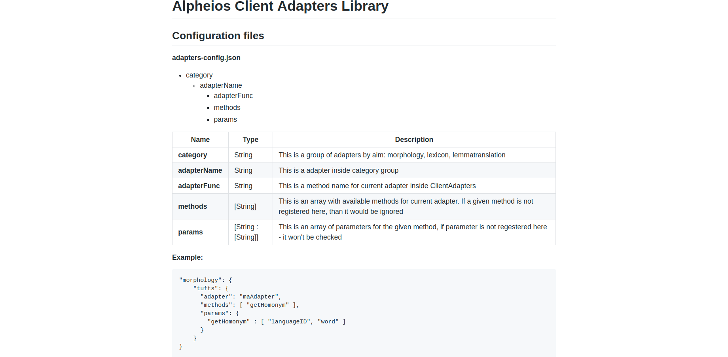
@Alpheios
Notes:
The client adapters library is easily extended with new adapters for additional services.

Slide 25
Alpheios Annotation Tools
Notes:
In our first round of development between 2007-2010, we invested considerable effort in exploring how annotations such as treebanks and aligned translations could be used to enhance texts with pedagogical capabilities.

Slide 26
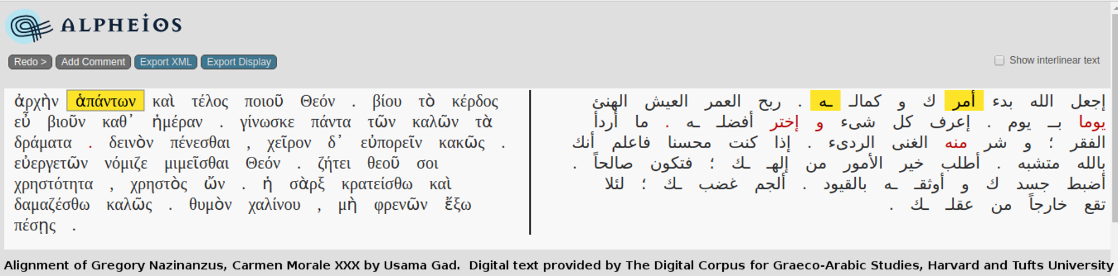
Alignment Editor
@Alpheios
Notes:
The alpheios alignment editor was originally designed to serve as a tool for us to use internally to curate and correct texts which had been automatically aligned using statistical machine translation methods. It turned out to be somewhat fun to use, and a pedagogical tool in its own right. I know many of you are familiar with this tool through its subsequent use as part of the Perseids platform.
This tool has lasted far longer than we originally envisioned when we first built it, and it is overdue for a rehaul.

Slide 27
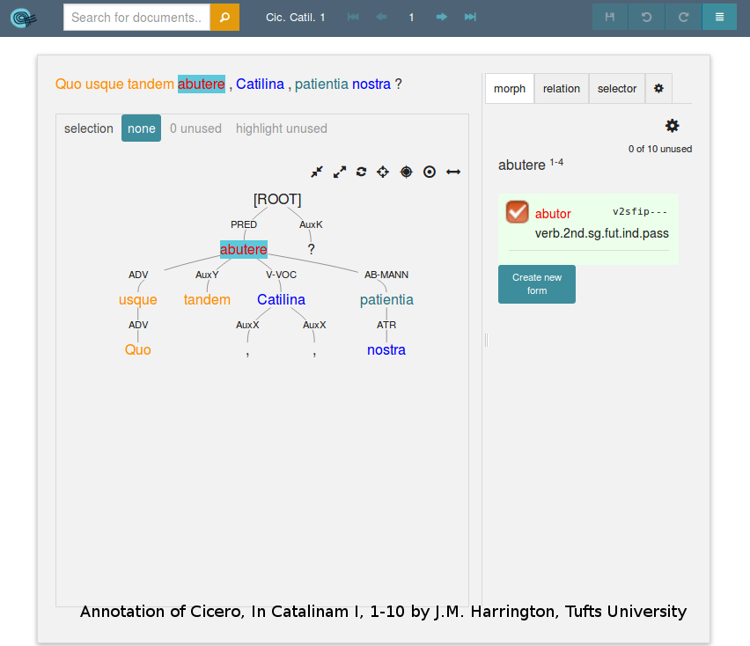
Arethusa - Treebank Editor
@Alpheios
Notes:
We also built a treebank editor to help speed up the manual creation and curation of treebank annotations. The initial interface was fairly simple and it inspired and informed the design of its successor, the Arethusa Treebank Editor. Arethusa was developed through the support of a number of different grants and projects while I was at Tufts, and Alpheios is currently a co-maintainer of it together with Zach Fletcher the new development lead of the Perseids Project

Slide 28
Roadmap
Alpheios 3.0 Reader + Embedded Library + Browser Extensions
Currently in Beta
Redesigned UI with Mobile support, User wordlists, Latin usage examples
Near Future
Localized User Interface
Textual annotations and commentary
Leveraging LASLA data for pedagogical games
Arabic improvements
Additional Linked Resources
Alignment Editor Rewrite
Audio Alignment Editor
...
@Alpheios

Slide 29
Long Term Goals
Individual Difference Measures
Dynamic User Proficiency Maps
Continuous comparison of learning interventions over time
Linking intervention data with intervention customization
Additional Languages
...
@Alpheios

Slide 30
Linked Resource Wishlist
Neural net parsers
Treebanks
Aligned Translations
Wordnet integration
Gazetteers
Corpus-based wordlists
Audio alignments
Images of manuscripts
Additional grammars and dictionaries

Slide 31
Mobile Reader Beta
Looking for user feedback on the responsive UI
Let us know if you want to participate

Slide 32
Thank you!
https://alpheios.net
support@alpheios.net
@Alpheios

